Slide 1
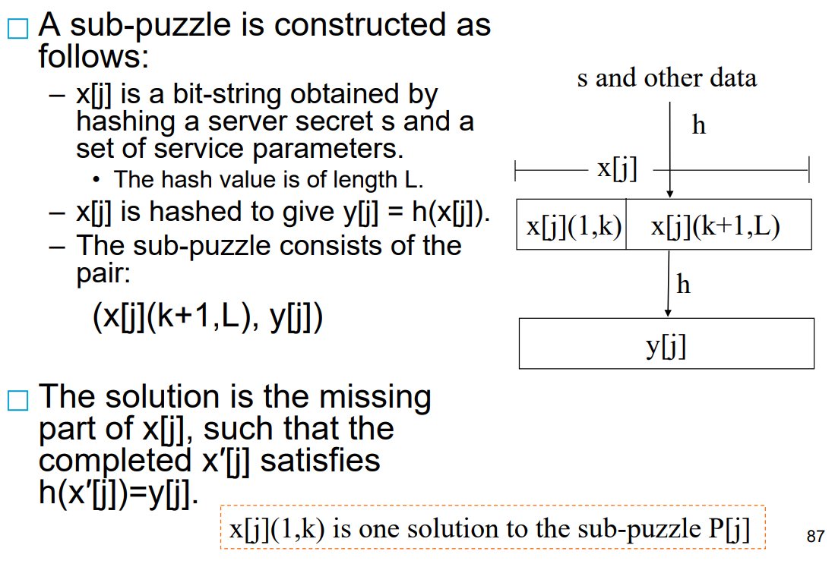

Slide 2
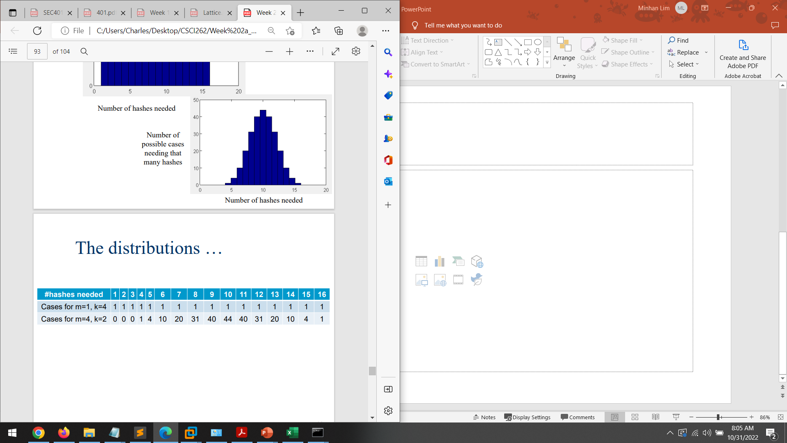
Hashes needed
4 – every case gets correct the first try
5 – one of the cases uses 2 hashes the rest use 1 hash – 4 permutation
6 – {3,1,1,1} or {2,2,1,1} = 4C1 x 3C3 + 4C2 x 2C2 = 4 x 1 + 6 x 1 = 10
7 – {4,1,1,1}, {3,2,1,1},{2,2,2,1}
= 4C1x3C3 + 4C1x3C1x2C2 + 4C3x1C1 = 4 + 4x3 + 4 = 20
8 – {5,1,1,1},{4,2,1,1},{3,3,1,1},{3,2,2,1},{2,2,2,2}
= 4x3 + 6 + 4x3 + 1 = 31

